Slide 1

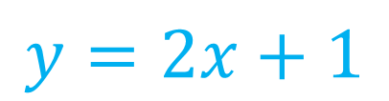


Algebra Interactive Notebook
$$3ab$$
$$\frac{5xy}{6}$$
Name :
Class :
Term 1 Semester 1
$$2x+3y$$
$$y=2x+1$$

Slide 2
Contents
Glossary
Page
Date
Description
2
3

Slide 3
Tasks
24
7
30
Essential Question
Questions
Notes
Summary
4
7

Slide 4
Simplifying Expressions
24
7
30
EQ: What is a ‘like term’ and how do I collect them?

Slide 5
Riddle of the day
There are 10 people on a boat and nobody is below deck but not a single person is in sight. How is this possible?

Slide 6
Answer
They are all married.

Slide 7
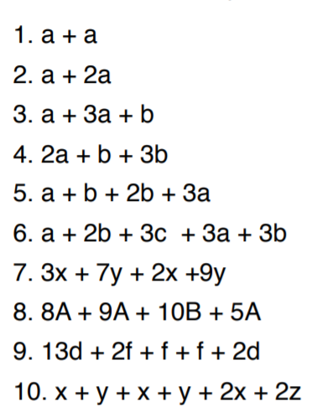
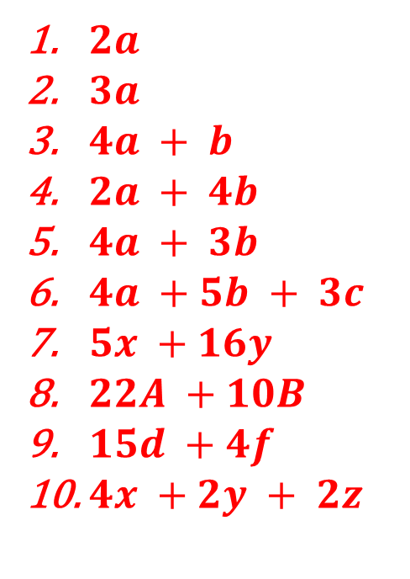
Revision - lhs
$2a$
$3a$
$4a + b$
$2a + 4b$
$4a + 3b$
$4a +5b + 3c$
$5x +16y$
$22A +10B$
$15d +4f$
$4x +2y + 2z$

Slide 8

Simplifying Expressions
24
7
30
EQ: What is a ‘like term’ and how do I collect them?
How do I multiply and divide like terms?
Simplify the following expressions
Example:
$4 ×3a =$
$3d ×4e=$
$6a ×3a=$
$5mn ×−2m$²$n$ =
Don’t forget
NUMBERS first
ALPHABET (in order) second

Slide 9
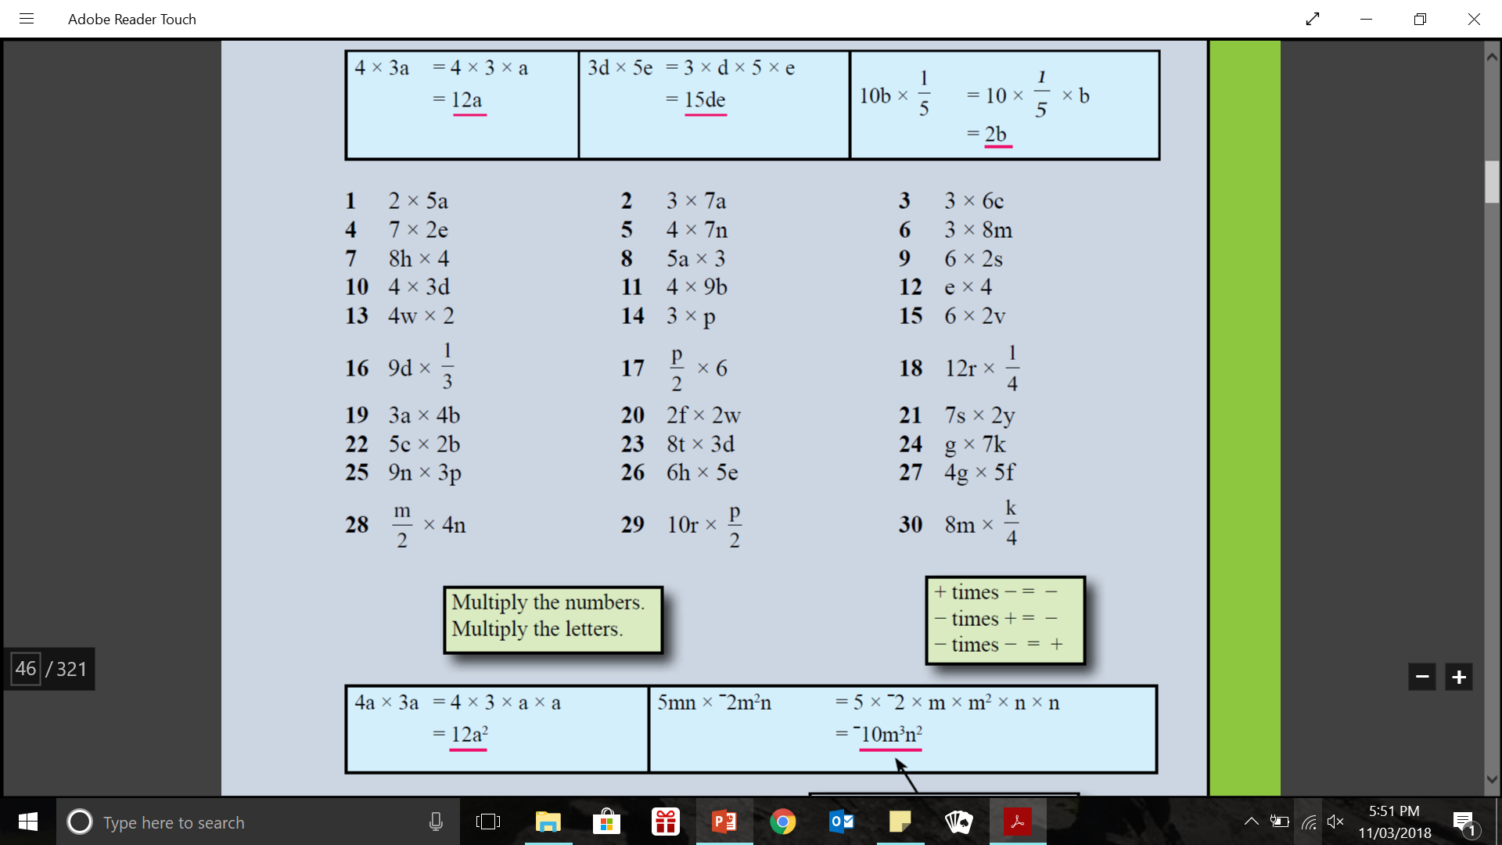
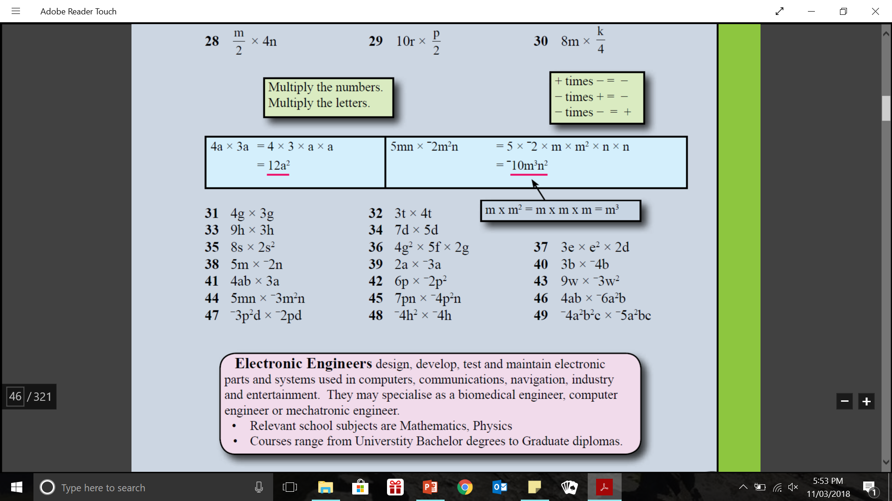
practice: - lhs

Slide 10

Simplifying Expressions
24
7
30
EQ: What is a ‘like term’ and how do I collect them?
How do I multiply and divide like terms?
Simplify the following expressions
Example:
$8b ÷2= \frac{8b}{2} = 4b$
$6d÷4d= \frac{6d}{4d} =$ $\frac{3}{2}$
$18ay÷4a= \frac{18ay}{4a} =$ $\frac{9y}{2}$

Slide 11
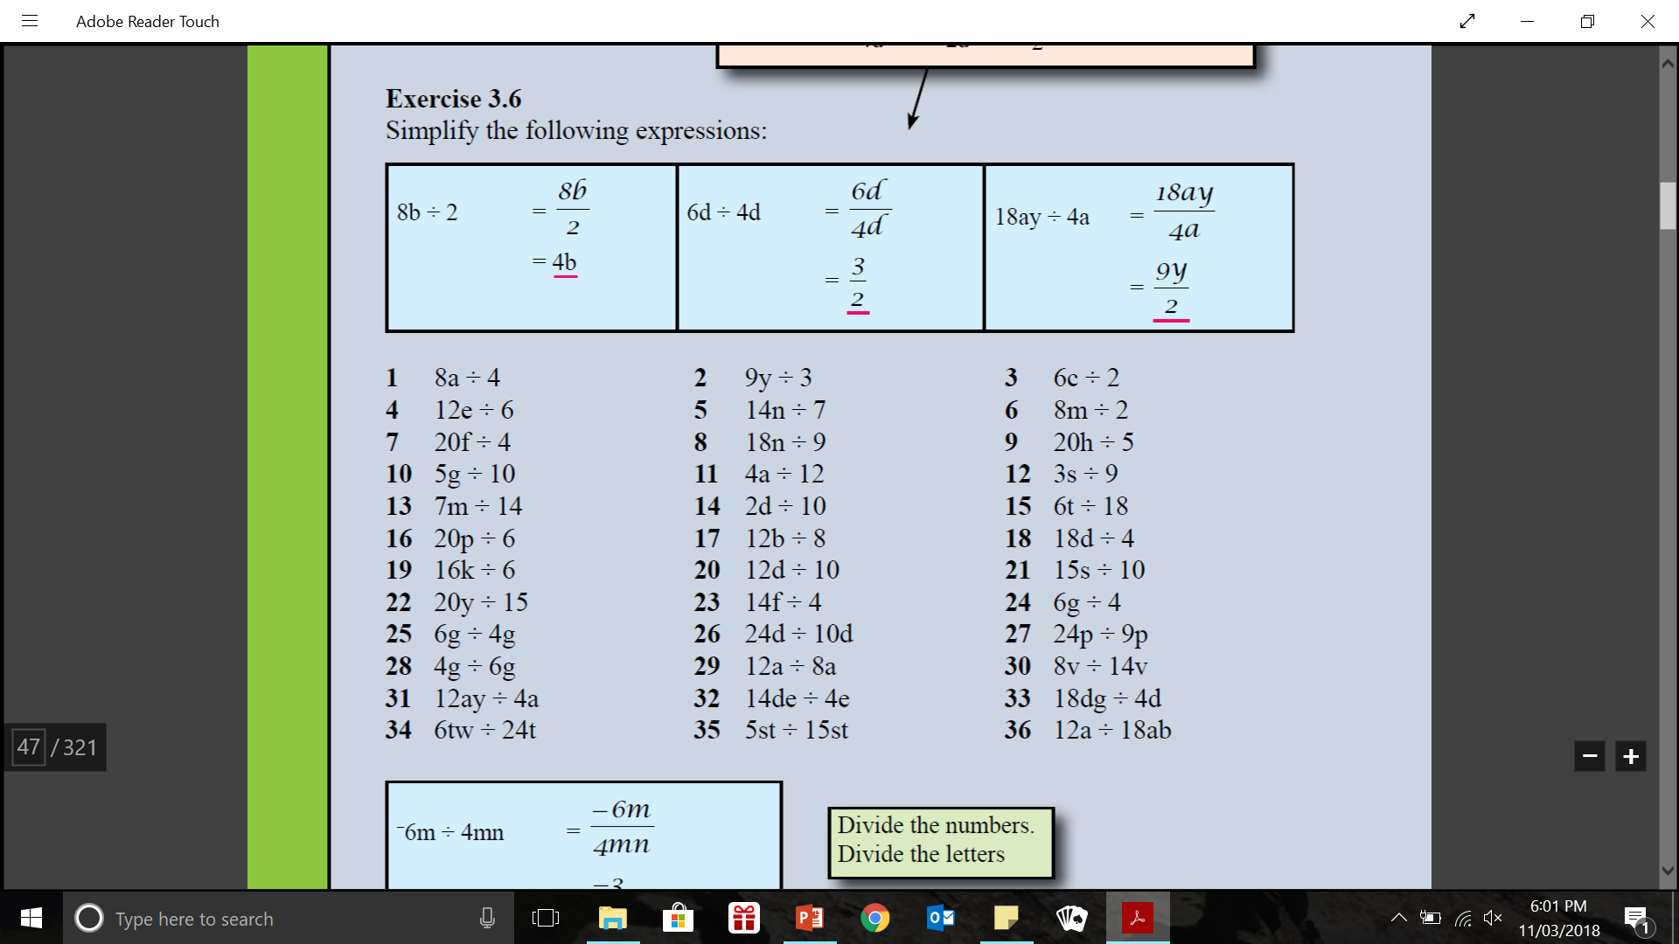
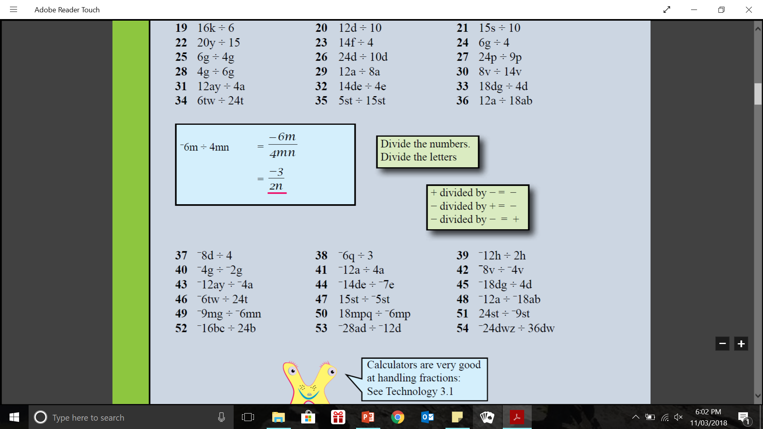
practice: - lhs

Slide 12
ESSENTIAL MATHEMATICS:
PAGE

